Slide 1
Down the Rabbit Hole with RabbitMQ
Discover the Joy of Multi-Platform Messaging
Jerry D’Antonio @jerrydantonio github.com/jdantonio
Notes:
1. VHT
* VHT (formerly Virtual Hold Technologies) in Akron
* Call center solutions for Fortune 500 companies
* Cable companies, airlines, credit card companies, video game console manufacturers
* Erlang and Ruby shop
* We build for scale
1. Navigator
* Team Lead for new product team
* New product is called Navigator
* Just released 1.0 to limited customers
* RabbitMQ central to architecture
* Recognized early the benefits of async
----- Meeting Notes (4/4/14 09:50) -----
Agenda:
* The case for async
* Message broker features
* Canonical use cases
* Navigator specific use cases
* Engineering principals

Slide 2
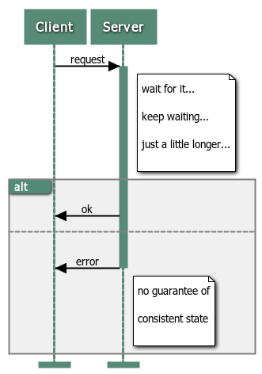
Synchronous Messaging
Notes:
1. Synchronous RPC
* Send a message (such as an HTTP request)
* Block, waiting for a response
* Response is received
* Unblock and move on

Slide 3
Synchronous RPC
Send a message (such as an HTTP request)
Block, waiting for a response
Response is received
Unblock and move on

Slide 4
Characteristics of Synchronous RPC
Success: Guarantee that the process is complete
Failure: Guarantee that the process did not complete
On failure the system may be in a corrupt state

Slide 5
Transactional RPC
Same message flow as synchronous
One important difference
Failure: Guarantee that the system is in a consistent state
Transactions are slower and more resource intensive
But provide better guarantees

Slide 6
Do We Need Guarantees?
Modern high availability can give high degree of confidence
Many operations are tolerant of failure
High volume operations depend on speed
As do many data-constrained clients (mobile devices)
Under the right circumstances, async is the way to go

Slide 7
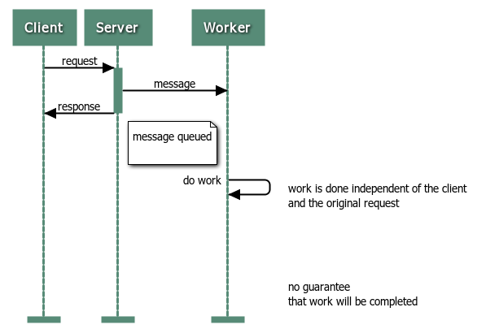
Asynchronous Messaging
Notes:
1. Asynchronous RPC
* Send a message (such as an HTTP request)
* Response is received
* Sender does not block
* Receiver performs operation *after* response sent

Slide 8
Asynchronous RPC
Send a message (such as an HTTP request)
Response is received
Sender does not block
Receiver performs operation after response sent

Slide 9
Characteristics of Asynchronous RPC
No guarantee on success
Success means the request was received
Success does not mean the request was processed
Failure on send means the message was not received
Which guarantees the system is still in a consistent state
Full success means the system will be eventually be consistent
Final disposition is a complete unknown
Response to the client is very, very fast

Slide 10

Enter the Rabbit

Slide 11
Enter the Rabbit
RabbitMQ is a high performance, multi-platform message broker
Uses asynchronous messaging
Publishers send messages
Consumers receive messages
Supports any programming language

Slide 12
Enter the Rabbit
Supports multiple protocols
Everything is loosely coupled
Completely distributed
Both HA and HP are supported
Configuration can be tailored for need

Slide 13
AMQP
Advanced Message Queuing Protocol
Programmable: artifacts created upon connection
Connection
Channel
Exchange
Queue
Connection and channel are low-level, programmatic
Exchange and Queue are where the real work gets done

Slide 14
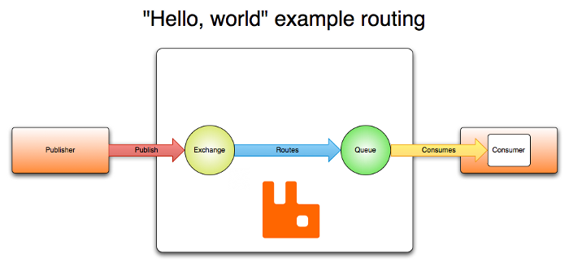
The AMQP Model
Notes:
1. The AMQP Model
* Publisher
* Publishes to the Exchange
* Message is routed to one or more Queues
* Consumers subscribe to queues
* From which messages are delivered

Slide 15
The AMQP Model
Publisher
Publishes to the Exchange
Message is routed to one or more Queues
Consumers subscribe to Queues
From which messages are delivered

Slide 16
Power in Simplicity
Publishers and consumers are decoupled and independent
Messages may be routed to multiple consumers
Queues may be mirrored or persisted (durable)
Without acknowledgements messages will be redelivered
Messages may be re-queued on failure

Slide 17
Exchanges
Manage delivery based on type and routing key
Type and name are set at creation
Routing key for message is set at publish
Messages are never stored in the exchange
Messages with no matching queues are dropped
Four types: Direct, Fanout, Topic, Header

Slide 18
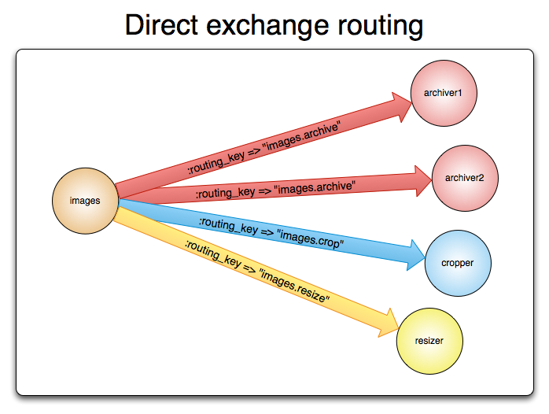
Direct Exchange

Slide 19
Direct Exchange
Delivery based on routing key
Intended for unicast routing
Message and queue routing key must match exactly
Supports multiple queues and multiple subscribers
Notes:
1. Direct Exchange
* Delivery based on routing key
* Intended for unicast routing
* Message and queue routing key must match exactly
* Supports multiple queues and multiple subscribers

Slide 20
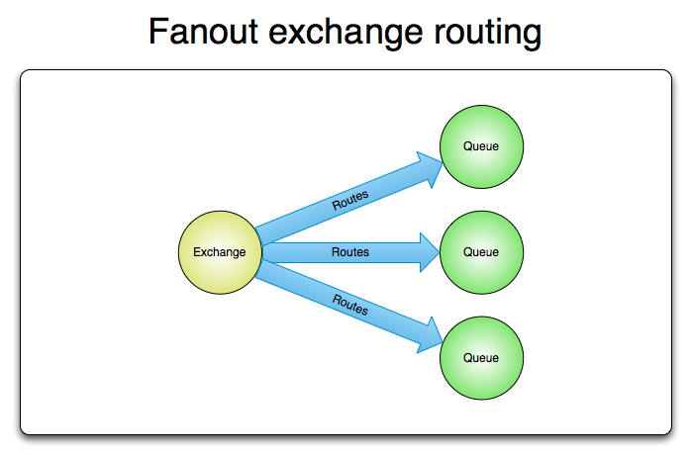
Notes:
1. Fanout Exchange
* Broadcast messages
* Routing key is ignored
* Many queues, many consumers

Slide 21
Fanout Exchange
Broadcast messages
Routing key is ignored
Many queues, many consumers

Slide 22
Topic Exchange
Delivery based on routing key
Intended for multicast routing
Messages are published with an explicit routing key
Consumers use wildcards when binding queues to exchanges
Supports multiple queues and multiple subscribers

Slide 23
Headers Exchange
Similar to Direct but uses headers rather than routing key
Queues can be bound to an exchange with multiple headers
Multiple headers may be matched with "any" or "all"

Slide 24
Queues
Queues are "bound" to exchanges by consumers
Queues store messages delivered by exchanges
When there are no consumers messages accumulate
Queues are ephemeral by default (do not survive restart)
Queues can be declared as persistent (survive restart)
The prefetch attribute is used to create fair dispatch
Messages must be explicitly acknowledged or rejected

Slide 25
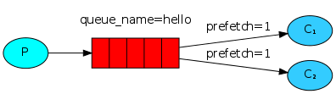
Work Queues
Notes:
* One publisher
* Direct exchange with routing key
* Many consumers on the same queue
* Fair dispatch delivery (prefetch = 1)

Slide 26
Work Queues
One (or more) publisher
Direct exchange with routing key
Many consumers on the same queue
Fair dispatch delivery (prefetch = 1)

Slide 27
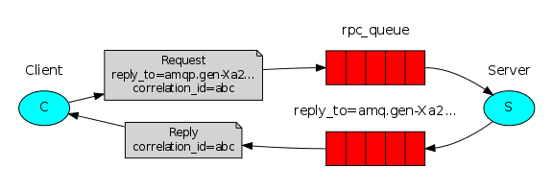
Remote Procedure Call
Notes:
1. Remote Procedure Call (RPC)
* Same basic setup as work queue
* But there is also a "reply-to" queue
* Client publishes to work queue
* Client adds "reply-to" as metadata
* Client then listens to reply-to queue
* Server publishes results to reply-to queue
* Client receives response

Slide 28
Remote Procedure Call (RPC)
Same basic setup as work queue
But there is also a "reply-to" queue
Client publishes to direct exchange
Client adds "reply-to" as metadata
Client then subscribes to reply-to queue
Server publishes results to reply-to queue
Client receives response

Slide 29
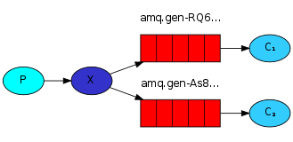
Publish/Subscribe
Notes:
1. Publish/Subscribe
* One publisher
* Fanout exchange (no routing key)
* Many consumers on one or more queues
* Every consumer receives every message

Slide 30
Publish/Subscribe
One (or more) publisher
Fanout exchange (no routing key)
Many consumers on one or more queues
Every consumer receives every message

Slide 31
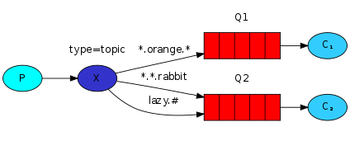
Topics
Notes:
1. Topics
* One publisher
* Topic exchange
* Every queue is bound with a routing key
* Queue routing keys support wildcards
* Many consumers on one or more queues
* Every message has a routing key
* Queues receive messages based on pattern matching

Slide 32
Topics
One (or more) publisher
Topic exchange
Every queue is bound with a routing key
Queue routing keys support wildcards
Many consumers on one or more queues
Every message has a routing key
Queues receive messages based on pattern matching

Slide 33
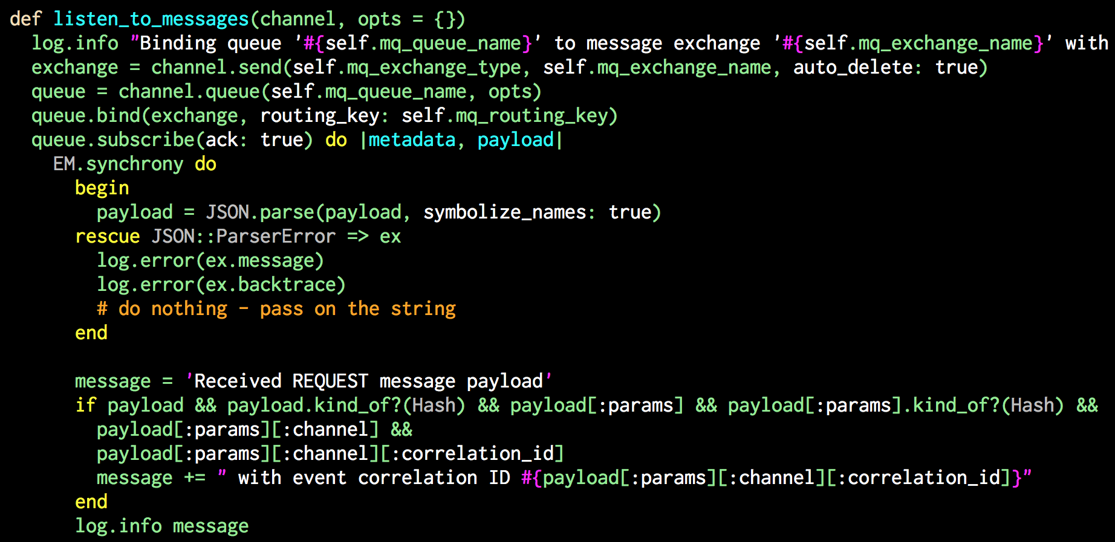
Navigator Work Queue
Notes:
1. Navigator Work Queues
* Basic direct exchange with fair dispatch
* Uses the default exchange
* Each worker type has its own routing key
* A message with no reply-to is a "cast"
* A message with a reply-to is a "call"
* This was we support both sync and async

Slide 34
Navigator Work Queues
Basic direct exchange with fair dispatch
Uses the default exchange
Each worker type has its own routing key
A message with no reply-to is a "cast”
A message with a reply-to is a "call”
This way we support both sync and async

Slide 35
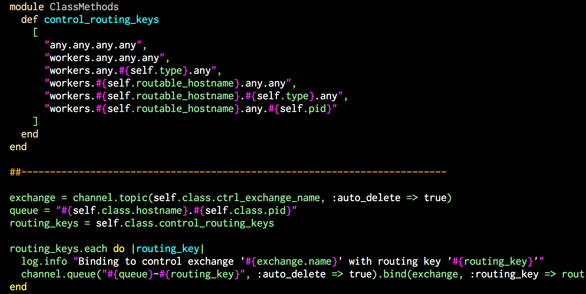
Navigator Control Exchange
Notes:
1. Navigator Control Exchange
* Peer-to-peer messaging
* Routing keys defined in product specs
* One topic exchange shared by all workers
* Each worker creates multiple queues
* Queues are bound 1:1 to routing keys
* Publisher selects recipients
* Each recipient receives intended messages

Slide 36
Navigator Control Exchange
Peer-to-peer messaging
Routing keys defined in product specs
One topic exchange shared by all workers
Each worker creates multiple queues
Queues are bound 1:1 to routing keys
Publisher “selects” recipients by choosing routing key
Each recipient receives intended messages

Slide 37
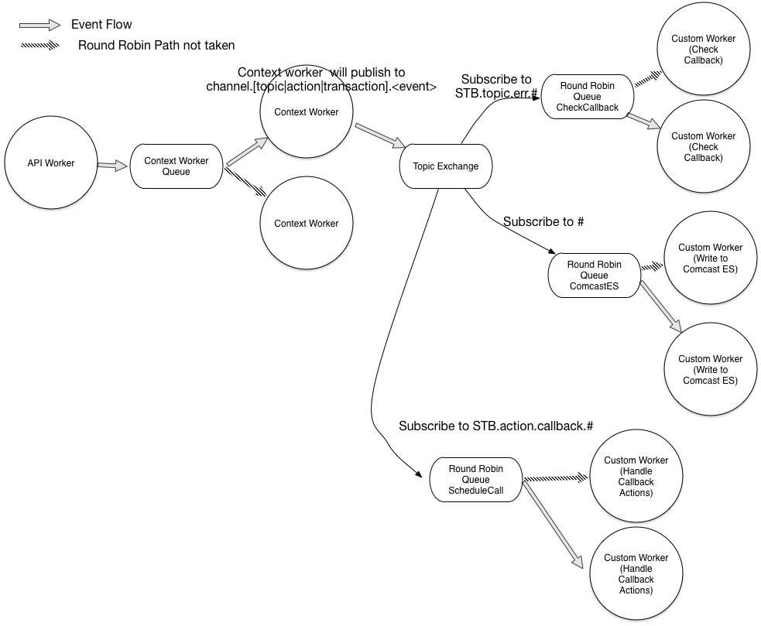
Navigator Republish
Notes:
1. Navigator Republish Exchange
* Context worker receives messages on work queue
* After processing a routing key is assigned
* Routing key is based on attributes of the event
* New message is published to a topic exchange
* Zero or more "secondary" workers
* Secondary workers bind to various routing keys
* Secondary workers select which messages to receive

Slide 38
Navigator Republish Exchange
Context worker receives messages on work queue
After processing a routing key is assigned
Routing key is based on attributes of the event
New message is published to a topic exchange
Zero or more "secondary" workers
Secondary workers bind to various routing keys
Secondary workers select which messages to receive

Slide 39
Architectural Principals
Eventual consistency
Best effort (no guarantees)
Degraded experience
Chunky over chatty
Resilience to transient errors
Favor idempotence

Slide 40
Future Topics
Exchange and queue attributes
Ack, nack, and reject
Transactions and confirms
Durable queues
Clustering
Mirrored queues
Plugins: Shovel and Federation
Management UI and CLI tools
Failover scenarios

Slide 41

We’re Hiring!
Shameless self-promotion, part I

Slide 42

concurrent-ruby.com
Modern concurrency tools for Ruby. Inspired by Erlang, Clojure, Scala, Haskell, F#, C#, Java, and classic concurrency patterns.
Shameless self-promotion, part II

Slide 43
Jerry D’Antonio
@jerrydantonio github.com/jdantonio virtualhold.com

